Slide 1

Cybersecurity of IoT and Semantic Web Workshop​
​
​
Presenter: Dr. Lavanya Elluri​
​Demonstration By Graduate Assistant: Sesha Sai Chennu​
​
​

Slide 2


Agenda
Why Cybersecurity of IoT?
​
Motivation
Semantic Web
Examples
Conclusion

Slide 3
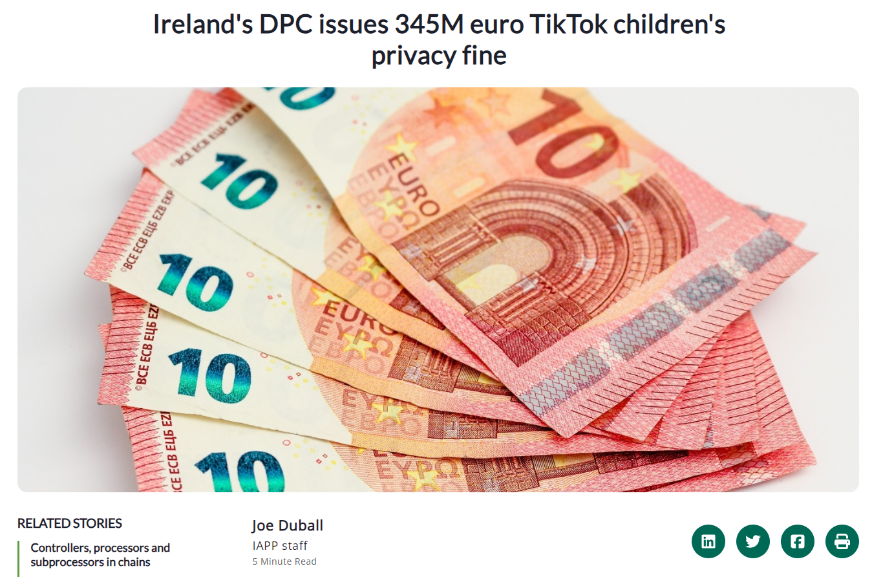
Motivation

Slide 4
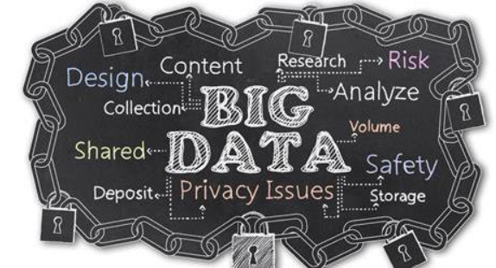
Motivation
Rapid adoption of Cloud computing for big data analytics has also resulted in a large volume of PII data being managed and transferred across the Internet.
Security and Privacy of observed or derived PII managed by vendors is of key concern to consumers.
Data protection regulations are currently available only in textual format and so require significant human time and effort to ensure compliance and thereby prevent data breaches. In the Ontology, we have identified the different roles and their corresponding obligations under the IoT regulations.

Slide 5
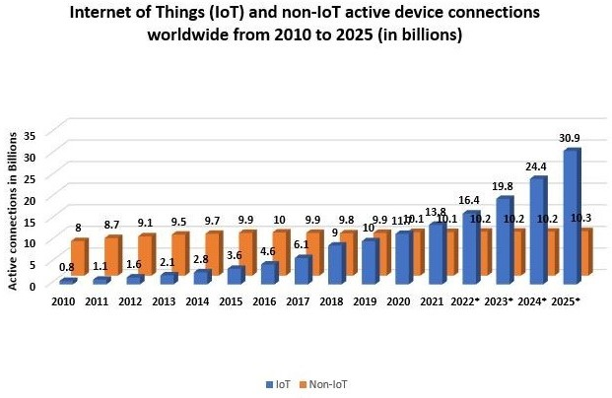
Motivation
IoT Device Growth
Security Challenges
Compliance Issues

Slide 6
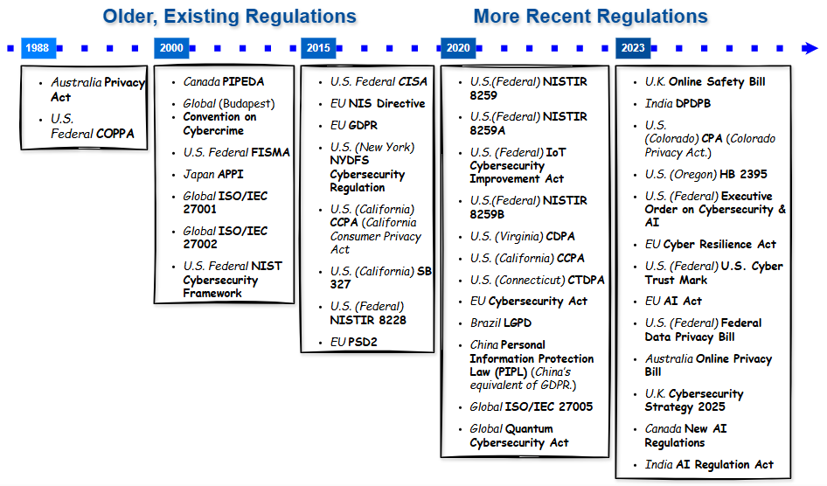
Compliance Pipeline
IoT Device Compliance Pipeline

Slide 7
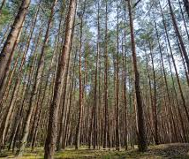
Data Protection Authorities/Regulators
Security and privacy concerns resulting in plethora of Data Regulations
Data Compliance Forest
US Laws: NIST data standards, CSA standards, PCI-DSS, Banking laws, HIPAA, COPPA
International law: EU’s GDPR, Chinese personal data law
Regulation is currently available only in textual format so manual effort is required ensure compliance.

Slide 8
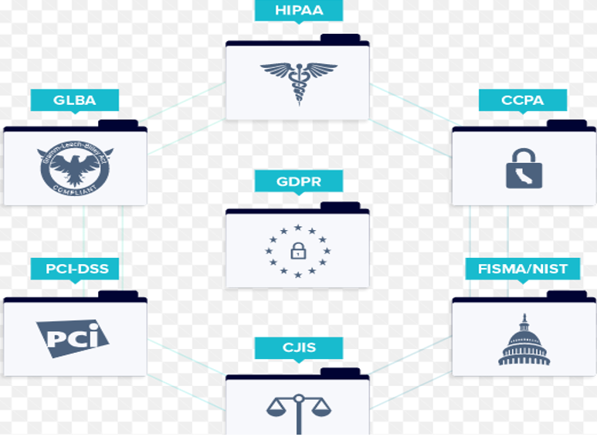
Regulation Documents

Slide 9
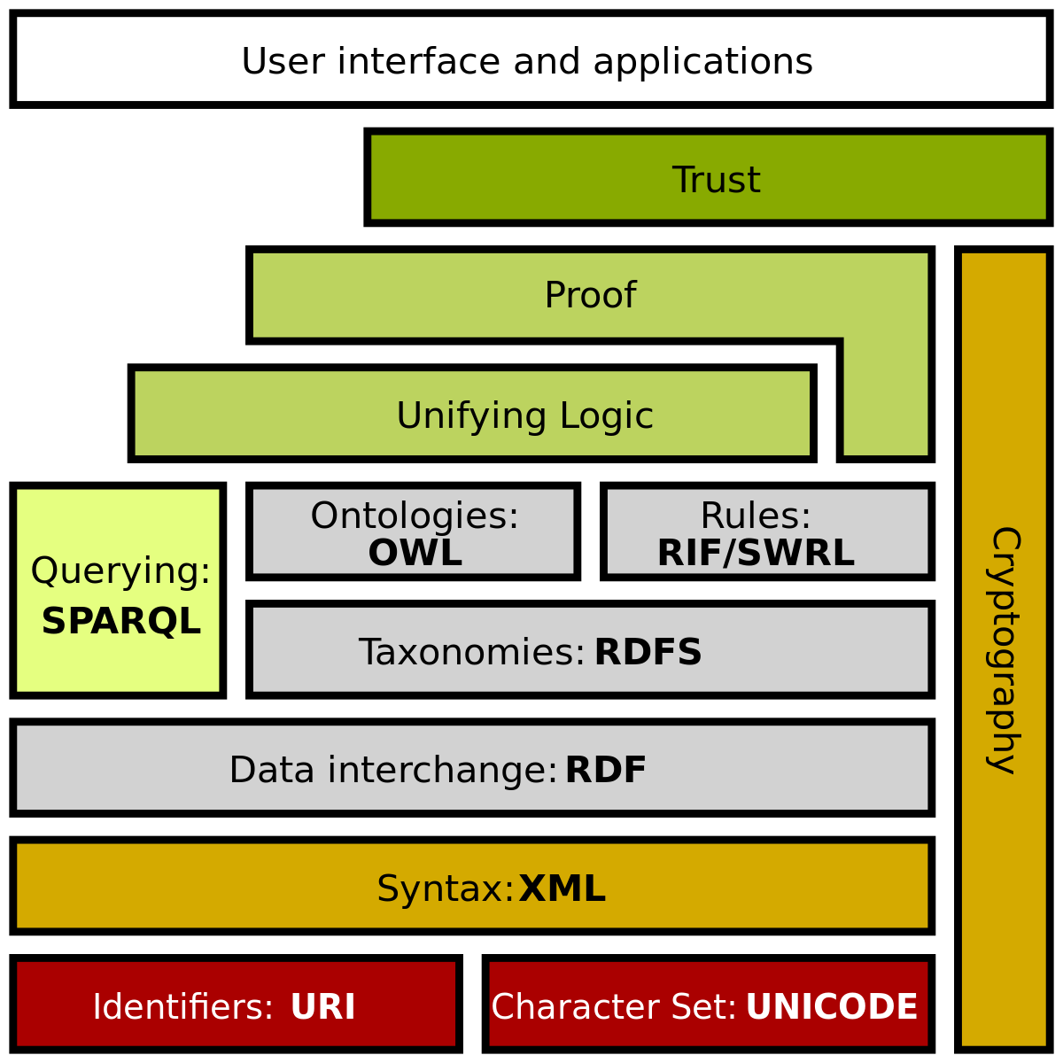
Semantic Web
Data can be annotated with machine understandable meta-data
Includes languages -
Resource Description Framework (RDF)
Web Ontology Language (OWL)
Provide common semantics of rules and policies of compliance documents

Slide 10
Semantic Web
What is the Semantic Web?
An extension of the web where data is machine-readable and interconnected.
Think of it as turning the web into a giant, smart database!
Tim Berners-Lee’s vision: "A web where data has meaning and links to other data."

Slide 11
Semantic Web
Improved data integration: Combine info from anywhere.
Better search: Find exactly what you need.
Data sharing: Reuse data across apps.
Automation: Let machines do the heavy lifting.
Example: Linking your social media to your favorite books seamlessly.

Slide 12
Real-World Applications
Real-World Applications
Linked Open Data: DBpedia (Wikipedia as data).
Knowledge Graphs: Google’s search magic.
Enterprise: Unifying company data.
Science: Sharing research datasets.
Remarkable fact: DBpedia lets you query Wikipedia like a pro!

Slide 13
Introduction to RDF
RDF = Resource Description Framework.
A way to describe data using triples: Subject, Predicate, Object.
Like sentences: "Alice knows Bob."
Think of it as the grammar of the Semantic Web.

Slide 14
RDF Triples
Subject: What’s being described (e.g., Alice).
Predicate: The relationship (e.g., knows).
Object: The value (e.g., Bob).
Diagram: [Arrow from Alice → knows → Bob]

Slide 15
RDF Triples
"Bob is a person":
http://example.org/bob rdf:type http://example.org/Person
"Alice knows Bob":
http://example.org/alice foaf:knows http://example.org/bob
Shown in Turtle: PREFIX foaf: <http://xmlns.com/foaf/0.1/>

Slide 16
RDF Triples
What is SPARQL?
SPARQL: Query language for RDF data.
Pronounced "sparkle" – it makes data shine!
Like SQL, but for the Semantic Web.
Ask your data questions and get answers.

Slide 17
RDF Triples
What is SPARQL?
SPARQL: Query language for RDF data.
Pronounced "sparkle" – it makes data shine!
Like SQL, but for the Semantic Web.
Ask your data questions and get answers.

Slide 18
SPARQL Query Structure
PREFIX: Define namespaces.
SELECT: What you want to see.
WHERE: Patterns to match.
Example: Goal: Find people named "Bob".
PREFIX foaf: <http://xmlns.com/foaf/0.1/>
SELECT ?person WHERE { ?person foaf:name "Bob" . }

Slide 19
SPARQL Query Structure
Data: Names and emails in RDF.
Query: Get all emails.
PREFIX ab: <http://example.org/addressbook#>
SELECT ?email WHERE { ?person ab:email ?email . }
Result: A list of email addresses.

Slide 20
SPARQL Query Structure
Query: Get Alice’s email.
PREFIX ab: <http://example.org/addressbook#>
SELECT ?email WHERE {
?person ab:name "Alice" .
?person ab:email ?email .
}

Slide 21
Filtering with FILTER
Add conditions with FILTER.
Example: Emails ending in ".com":
PREFIX ab: <http://example.org/addressbook#>
SELECT ?email WHERE {
?person ab:email ?email .
FILTER regex(?email, "\.com\$")
}

Slide 22
Example with FILTER
Add conditions with FILTER.
Example: Emails ending in ".com":
PREFIX ab: <http://example.org/addressbook#>
SELECT ?name WHERE {
?person ab:name ?name .
FILTER regex(?name, "^A")
}

Slide 23
Optional Patterns
OPTIONAL: Get data if it’s there.
Example: Names and phones (if available):
PREFIX ab: <http://example.org/addressbook#>
SELECT ?name ?phone WHERE {
?person ab:name ?name .
OPTIONAL { ?person ab:phone ?phone . }
}

Slide 24
Running SPARQL Queries
Tools:
ARQ (command-line).
Online endpoints (e.g., DBpedia).
Apps with SPARQL support.
You can try: Query DBpedia at http://dbpedia.org/sparql

Slide 25
Resources for Further Learning
Book: "Learning SPARQL" by Bob DuCharme.
W3C: SPARQL specs at w3.org.
Tutorials: W3C, Linked Data sites.
Courses: Check Coursera or edX.

Slide 26

Deontic Logic
Permissions/Rights - Rights or authorizations for an entity/actor.
Obligations - Responsibilities of an entity/actor .
Prohibitions - Conditions or actions are not permitted.
Dispensations - Optional or non-mandatory statements.
Examples from existing policies:
Customer must also provide Google with server log files showing loss of external connectivity errors and the date and time those errors occurred.
At our discretion we may issue the Service Credit to the credit card you used to pay for the billing cycle in which the Unavailability occurred.
Permission | Dispensation | Obligation | Prohibition
may will be can could | may not will not be can not could not | must should shall | must not should not shall not

Slide 27
Permission & Obligations:
Sentences that have verbs like ‘may’, ‘can’, ‘could’ ‘will’ were categorized as Permissions and sentences having verbs like ‘shall’, ‘must’ ‘should’ were categorized as Obligations. Below mentioned are some examples of our context:
Permissions:
“Requirement 7: Restrict access to cardholder data by business need to know. To ensure critical data can only be accessed by authorized personnel, systems and processes must be in place to limit access based on need to know and according to job responsibilities” .
Obligations:
“Requirement 10.7 Retain audit trail history for at least one year; at least three months of history must be immediately available for analysis”.
Permissions:
“A group of undertakings may appoint a single data protection officer provided that a data protection officer is easily accessible from each establishment”.
Obligations:
“The controller shall implement appropriate technical and organizational measures for ensuring that, by default, only personal data which are necessary for each specific purpose of the processing are processed”.

Slide 28
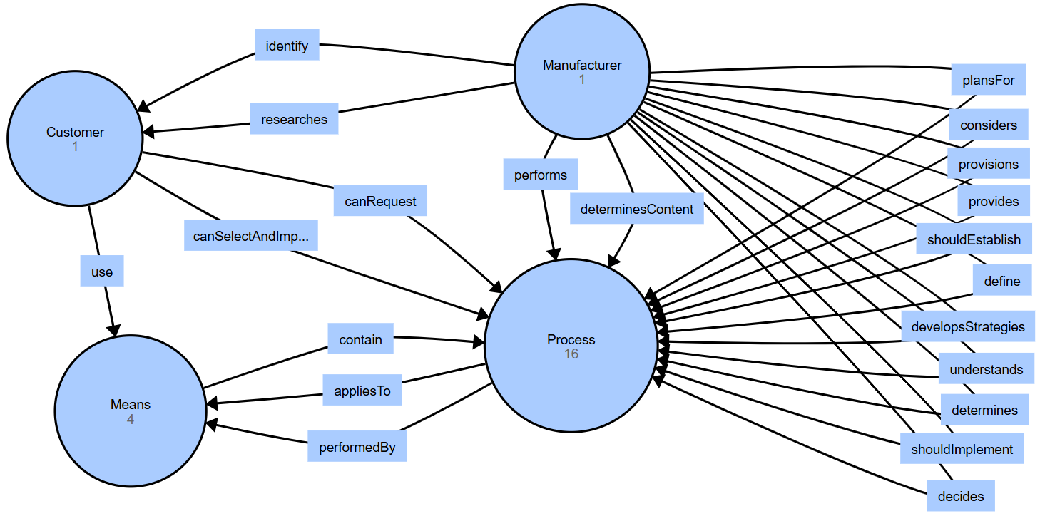
NIST 8259 Ontology

Slide 29
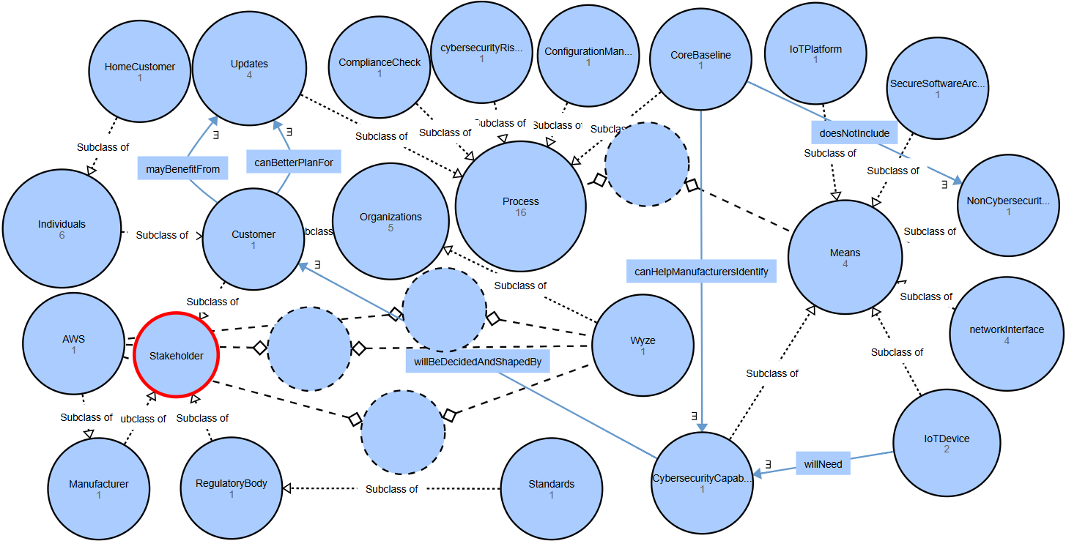
NIST 8259 Ontology

Slide 30
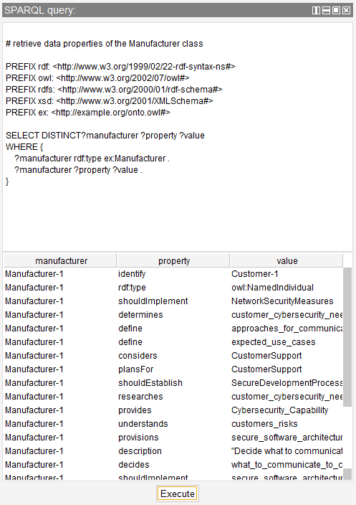
SPARQL Query
Object properties
&
data properties
of
Manufacturer class

Slide 31
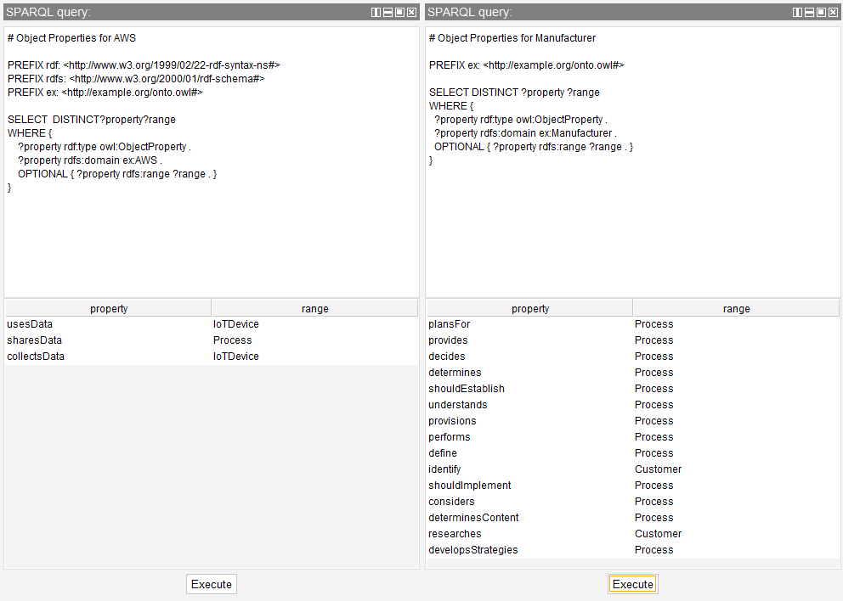
SPARQL Query

Slide 32
Summary
Semantic Web: Smart, linked data.
RDF: Triples for structure.
SPARQL: Query it with SELECT, FILTER, etc.
You’re ready to explore the web of data!

Slide 33
Future Directions
Scaling and Optimization
Data storage and retrieval mechanisms for larger datasets and big data potential.
Plans for public hosting of the system.
Sophisticated reasoning capabilities over the KG.

Slide 34
Conclusion
Innovative Approach
Automated IoT cybersecurity compliance framework
Enhanced Compliance Verification
Significant improvements in compliance accuracy
Precise and contextually relevant checks for manufacturers.

Slide 35
References
F. Z. Amara, M. Hemam, M. Djezzar, and M. Maimor, “Semantic Web and Internet of Things: Challenges, Applications and Perspectives,” ICOSI Laboratory, Khenchela, Algeria, 2023.
U.S. Congress, “Internet of Things Cybersecurity Improvement Act of 2020,” U.S. Government Publishing Office, Tech. Rep., 2020.
T. W. House, “Improving the Nation’s Cybersecurity,” Executive Office of the President, Tech. Rep., 2021.
J. T. Force, “NISTIR 8259: Foundational Cybersecurity Activities for IoT Device Manufacturers,” 2020. Available: doi.org/10.6028/NIST.IR.8259
K. Boeckl et al., “Considerations for Managing Internet of Things (IoT) Cybersecurity and Privacy Risks,” National Institute of Standards and Technology, 2019.
L. S. Vailshery, “Global IoT and Non-IoT Device Connections 2010-2025 [Chart],” Statista, 2022. Available: statista.com
Z. Xu, Y. Sheng, L. He, and Y. Wang, “Review on Knowledge Graph Techniques,” Journal of the University of Electronic Science and Technology of China, 2016.
W3C, “SPARQL 1.1 Overview,” 2013. Available: w3.org
L. Sciullo et al., “A Survey on the Web of Things,” Journal of Internet of Things, vol. 1, pp. 1–10, 2022.
J. L. Hernández-Ramos et al., “Defining the Behavior of IoT Devices through the MUD Standard,” IEEE Internet of Things Journal, vol. 8, no. 5, pp. 3921–3935, 2021.
J. T. Force, “NIST Special Publication 800-53 Revision 5,” 2020. Available: doi.org/10.6028/NIST.SP.800-53r5
J. Hebeler, M. Fisher, R. Blace, and A. Perez-Lopez, Semantic Web Programming, John Wiley & Sons, 2011.
G. Antoniou and F. Van Harmelen, A Semantic Web Primer, MIT Press, 2004.
T. B. Passin, Explorer’s Guide to the Semantic Web, Manning Publications, 2004.

Slide 36

Q&A Session
?

Slide 37

Contacts
Lavanya Elluri
elluri@tamuct.edu
Sesha Sai Chennu
Sesha.Chennu@tamuct.edu
Mohammad Qadir
m.qadir@tamuct.edu
This work was supported by NSF award #2348147

Slide 38
Thank You
This work was supported by NSF award #2348147

